Slide 1
Chaser 2 — Integration
Rachel VanRyzin, Isabella Knox, 4/10/19

Slide 2
Biggest Successes
Biggest Challenges
Successfully communicates hit/miss array with Beater 2
Successfully reads pair score character from Beater 2 and translates to decimal score
Our LCD is broken
Unfortunate coincidences with hub code
Timing
Debugging conjoined code

Slide 3
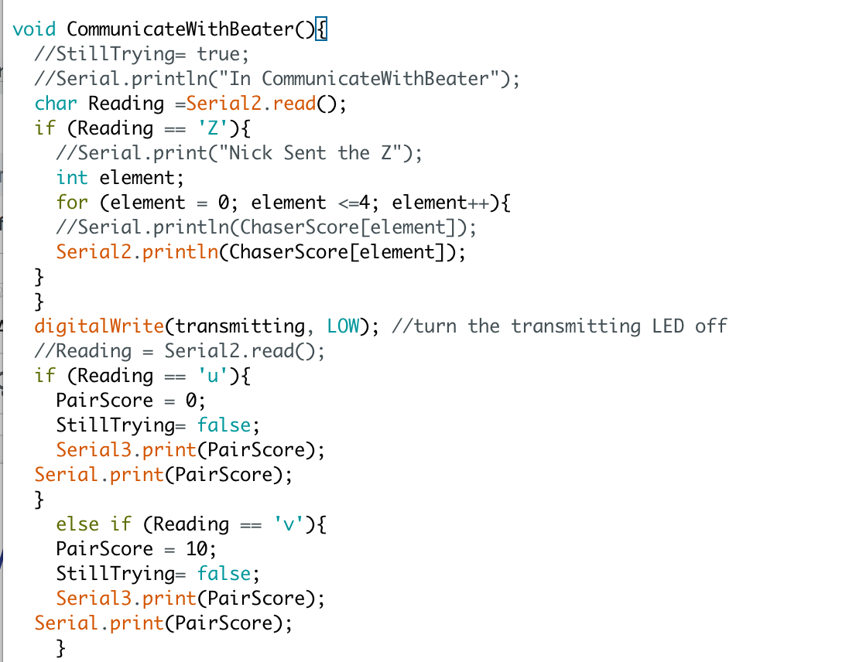
New Code
← A new function, to be called once our bot hits the last hash

Slide 4
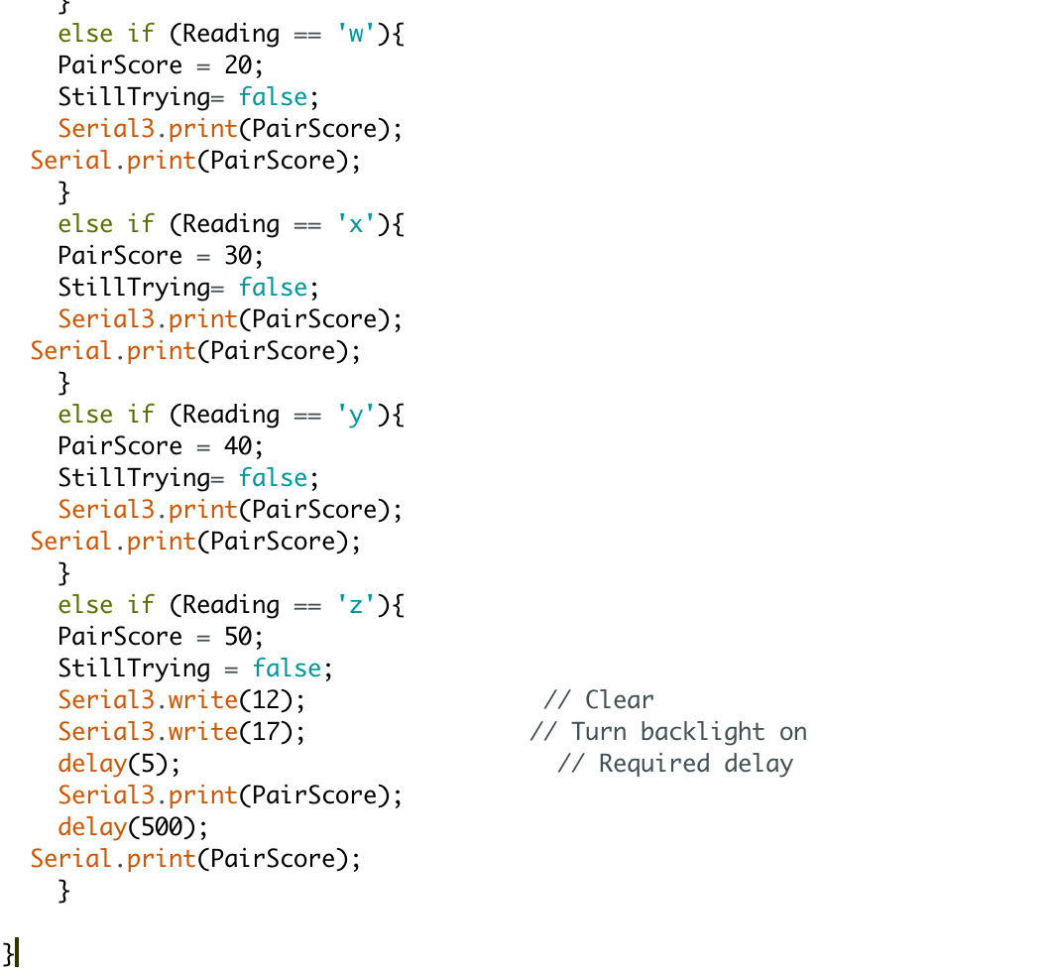

Here’s where the new function gets called in the main loop↓

Slide 5
Next Week
Get new, working LCD
Communication and integration with whole team

Slide 6
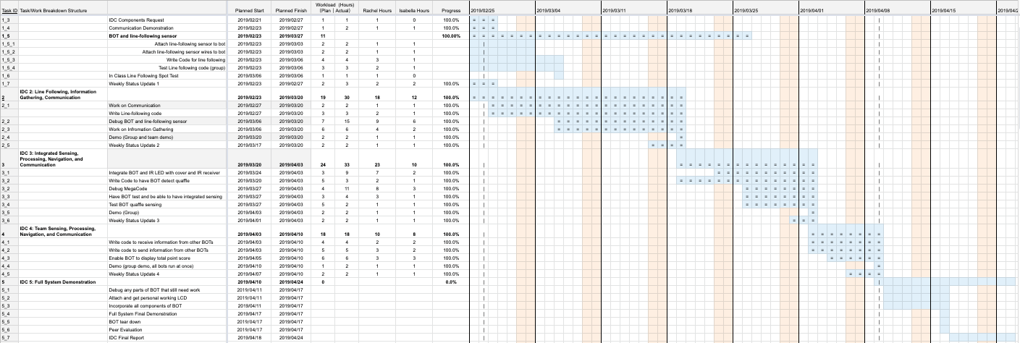
Gantt Chart

Slide 7
Cost Added This Week
Score Display Sensor (added 4/9/19)
2x16 Serial LCD (1) | $29.99
3-pin m/m header (1) | $0.50
Total Cost of parts ON bot: | $96.31
Total Cost of bot and parts: | $295.31

